Slide 1
HEART DISEASE PREDICTION
TSP- AI ML Fundamentals (Capstone Project)
Presented By:
Student Name: K.DIVYA – NM ID: 641174D606C1688951743FF3A72A0211 au950021135013
College Name: ANNA UNIVERSITY REGIONAL CAMPUS TIRUNELVELI
Guided By: Ramar Bose

Slide 2
OUTLINE
Problem Statement (Should not include solution)
Proposed System/Solution
Algorithm & Deployment
GitHub Link
Project Demo(photos / videos)
Conclusion
Future Scope
References

Slide 3
Problem Statement
Heart Disease can be managed effectively with the combination of lifestyle changes ,medicines and in some cases,surgery with the right treatment,the symptoms of heart disease can be reduced and the functioning of the heart improved.The predicted results can be used to prevent and thus reduce the cost for surgical treatment and other expensive.
The aim is to create reliable tools for early detection and prevention of heart-related ailments.

Slide 4
Proposed Solution
To predict the heart attack disease
It helps in reducing treatment costs by providing effective treatments.
To find the parameters values in prediction like accuracy, elapsed time
And energy consumption

Slide 5
Algorithm & Deployment
Random Forest Classifier: Random forest are ensemble learning methods that combine multiple decision trees.They are robust, handle noisy data and can capture complex relationships
K Nearest Neighbors (K-NN): K-NN is a simple effective algorithm. It classifies data points based on tha majority class among their K nearest neighbors.

Slide 6
GitHub Link
https://github.com/DivyaK-013/NAAN-MUDHALVAN-PROJECT-HEART-DISEASE-PREDICTION.git

Slide 7
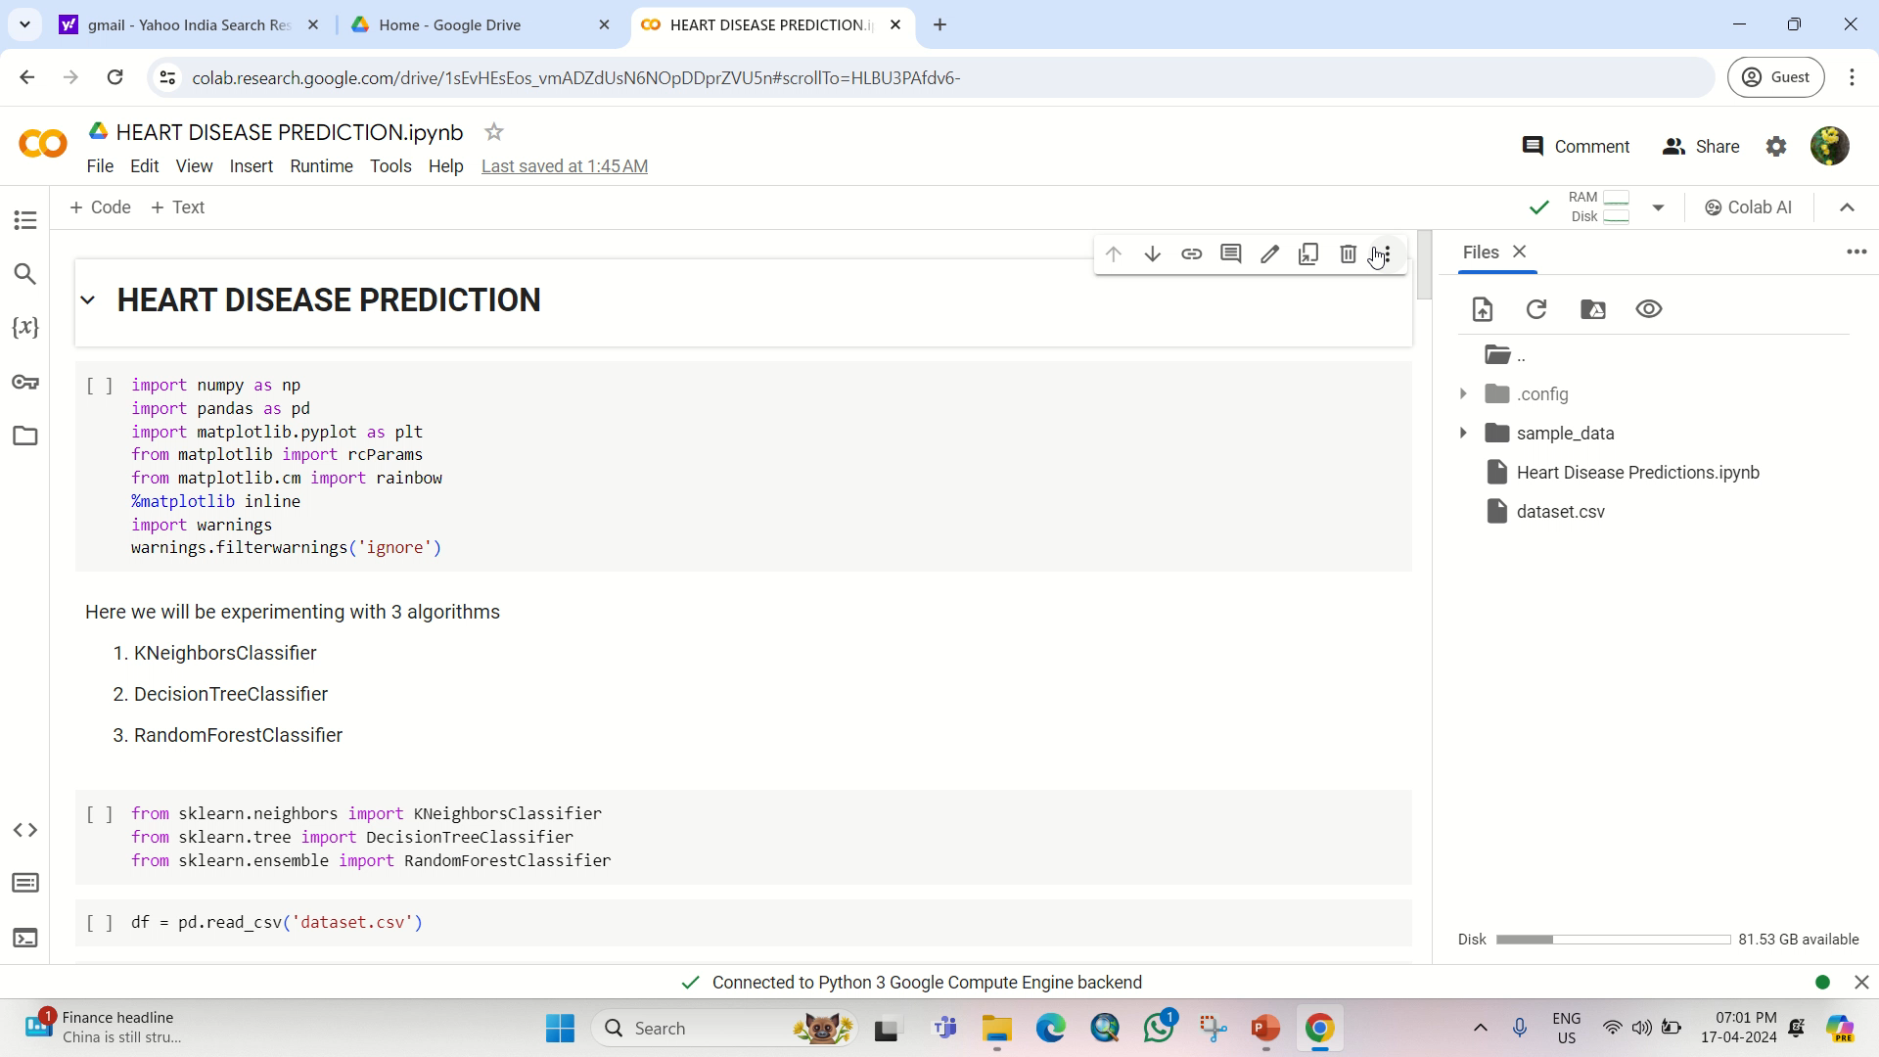
Project Demo(Recorded Video)

Slide 8
Conclusion
Correlation-based Feature Subset Selection method with the Best First Search has been carried out to select the most significant features. It has been discovered that all of the features are not strongly connected and that a combination of just 14 features (age, gender, smoking, obesity, diet, physical activity, stress, chest pain type, previous chest pain, blood pressure diastolic, diabetes, troponin, ECG, and target) significantly contribute to the prediction of heart disease. Finally, the datasets containing his research has provided a comprehensive study of patient characteristics for heart all features and selected features are used to develop seven AI (logistic regression, Naïve Bayes, K-NN, SVM, decision tree, random forest, and MLP) methods

Slide 9
Future Scope
Precision Medicine: Future approaches to predicting heart disease will likely rely more on precision medicine. This concept involves tailoring medical care, including prevention strategies, to individual differences in people's genes, environments, and lifestyles.
Collaboration and Research: Collaboration between researchers, clinicians, and data scientists is essential. Continued research, validation, and refinement of prediction models will drive progress in heart disease prevention and management.

Slide 10
References
See discussions, stats, and author profiles for this publication at: https://www.researchgate.net/publication/331589020
Heart Disease Prediction System
Research Proposal · March 2019
CITATIONS
2
Heart disease prediction using machine learning
algorithms
To cite this article: Harshit Jindal et al 2021 IOP Conf. Ser.: Mater. Sci. Eng. 1022 012072

Slide 11
THANK YOU

